Slide 1
WEB SERVICES

Slide 2
Web Services Definition
A Web service is a software component designed to support interoperable machine-to-machine interaction over a network. It has an interface described in a machine-processable format (typically, WSDL for SOAP based services).
In simpler words, a Web Service is a legacy application that is web-enabled. It is a “service” built over the web.

Slide 3
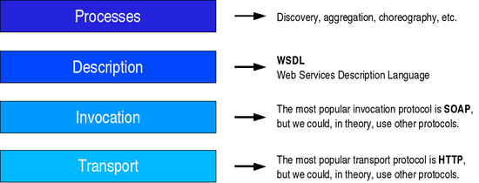
Web Services

Slide 4
Web Services..
Basically 2 types.
1. RESTful : based on REST
II. WS-* : Based on SOAP (WS stands for Web Service)

Slide 5
SOAP based Web Services
The 3 main components here are:
SOAP- Simple Object Access Protocol. It is XML – based. (XML messages are wrapped over by SOAP tags).
WSDL – Web Services Description Language. It is again XML based and is used to locate and describe Web Services.
UDDI - Universal Description, Discovery and Integration. It is a directory service where companies can register and search for SOAP-based Web Services.

Slide 6
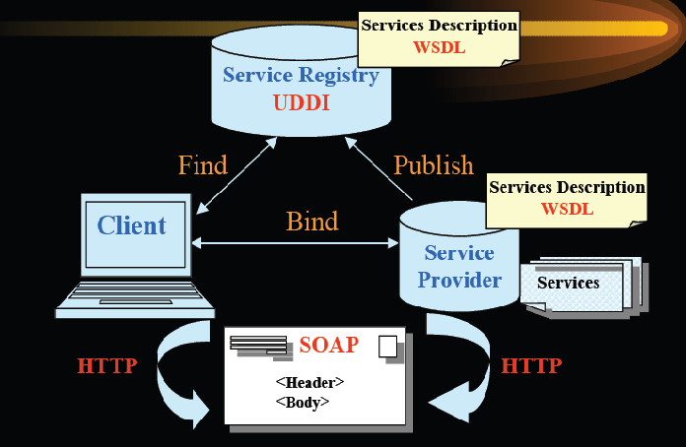
SOAP-based Web Service…

Slide 7
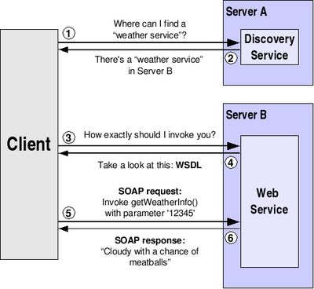
WEB SERVICES.. SOAP based (small correction here. WSDL is sent to the client by the Discovery service and not by Server B as shown in the diagram)

Slide 8
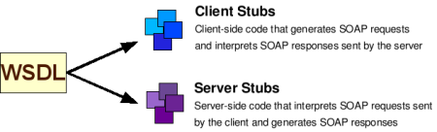
Necessity of stubs

Slide 9
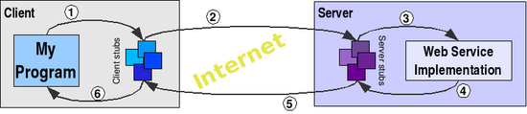
Web Service call

Slide 10
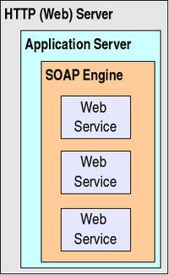
Server side

Slide 11
REST-ful Web Services
These Web Services are based on REST principles.
REST-compliant Web services are those, in which the primary purpose of the service is to manipulate XML/JSON representations of Web resources using a uniform set of “stateless" operations;

Slide 12
REST Principles
REST stands for Representational State Transfer. It is an architectural model based on some constraints.
In this model, there are “resources”, “representations” of the resources and “connectors” to connect the resources and representations.

Slide 13
REST Principles
Ex: An image is a resource. JPEG/PNG is a representation of the image.
Ex2: Data in a database is the resource. This resource can be represented as an html, xml or json.

Slide 14
REST constraints
The architecture is Client-Server based.
All operations are stateless.
Clients must have an ability to cache server responses.
Server must have a layered architecture. (end server must be hidden from client)
All modules must have a “uniform interface” so that they can evolve independently.

Slide 15
RESTful Webservices…
The World Wide Web complies with all these constraints and hence the WWW architecture is RESTful.
In RESTful Webservices, the WWW is used to implement the services.

Slide 16
REST-ful Web Services
The URI acts as the object and it usually supports the basic CRUD operations. (Create, Read, Update and Delete).
Many of the web-services today are moving towards RESTful services.
When implemented with a PHP, a single script performs Create (POST), Read (GET), Update (PUT) and Delete (DELETE) operations.

Slide 17
REST-ful Web Services
But 4 URIs are provided for the four operations. The URLs and rewritten (mapped) to the single PHP which then does the job. The return value is XML or JSON.
The mapping is performed in the Web Server’s config file.

Slide 18
REST-ful vs SOAP-based
REST-ful Web Services are easier to implement. (SOAP based are very complex. SOAP based are also called WS* based Web Services)
RESTful messages are more compact compared to WS*. This results in bandwidth savings.
RESTful messages are more human-readable.

Slide 19
REST-ful vs SOAP-based…
REST-ful services assume point-to-point communication. This is a disadvantage.
REST lacks standards for security policy. SOAP scores here.

